Slide 1
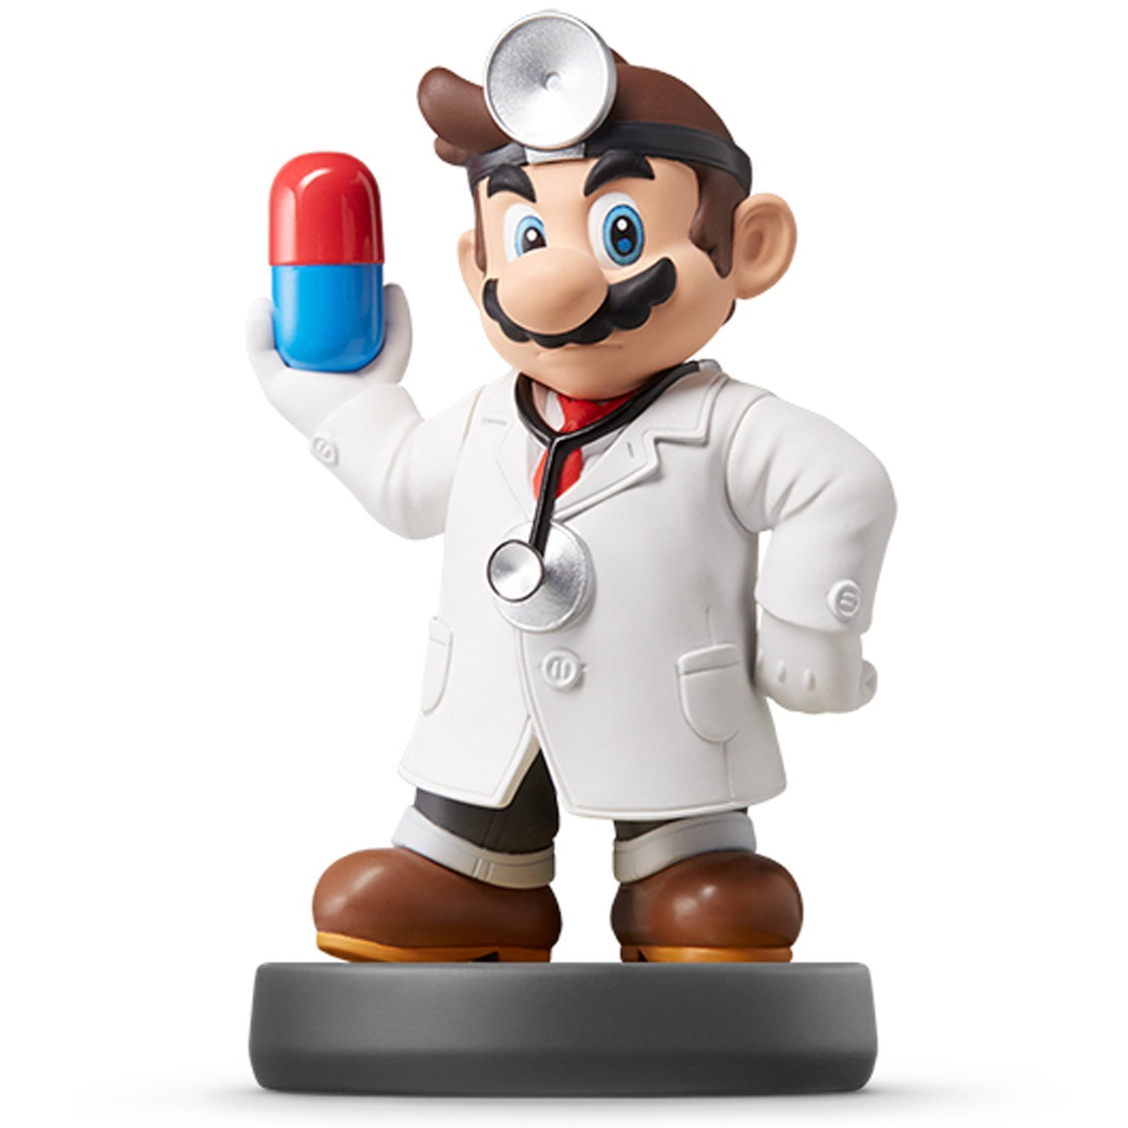
Regression I

Slide 2
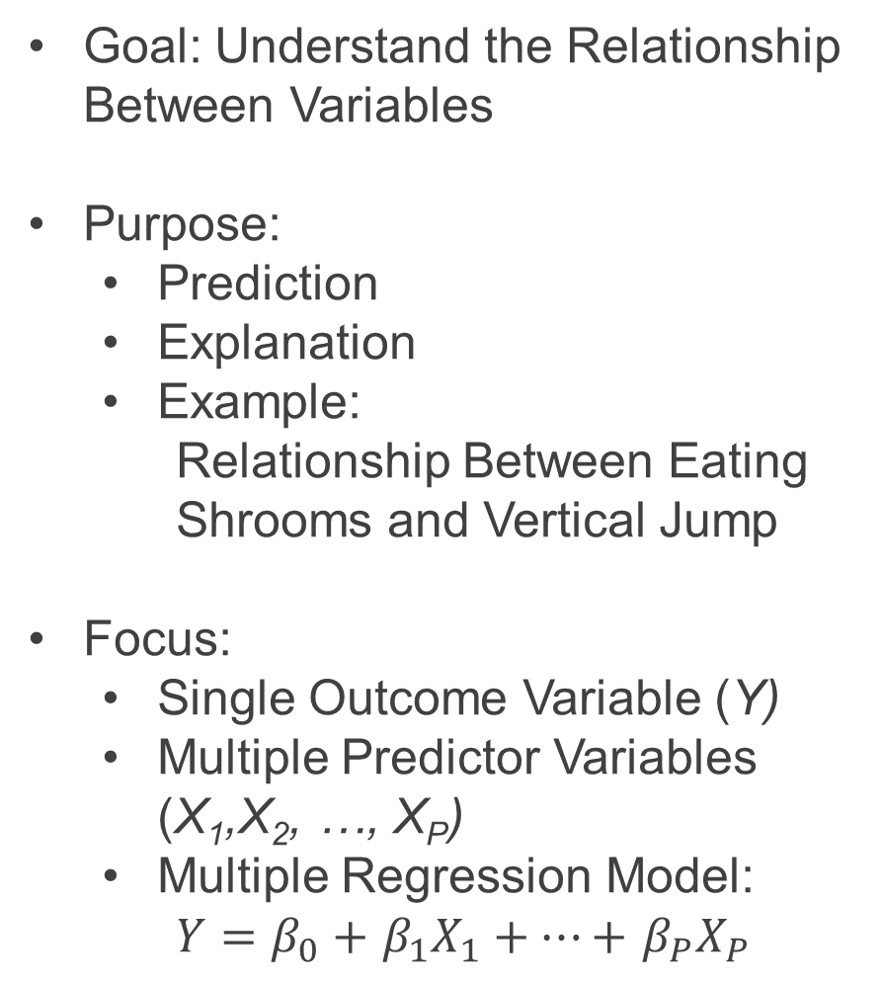
Introduction to Modeling
Goal: Understand the Relationship Between Variables
Purpose:
Prediction
Explanation
Example:
Relationship Between Eating Shrooms and Vertical Jump
Focus:
Single Outcome Variable (Y)
Multiple Predictor Variables (X₁,X₂, …, X_{P})
Multiple Regression Model:
$Y=β_{0}+$ $β_{1}X_{1}+…+$ $β_{P}X_{P}$

Slide 3
Some Dope Quotes
George Box
“All models are wrong, but some are useful”

Slide 4
Closing
Disperse and Make Reasonable Decisions

